Slide 1

Predictive Learning from Data
LECTURE SET 8
Methods for Classification
Electrical and Computer Engineering

Slide 2
OUTLINE
Problem statement and approaches
- Risk minimization (SLT) approach
- Statistical Decision Theory
Methods’s taxonomy
Representative methods for classification
Practical aspects and examples
Combining methods and Boosting
Summary

Slide 3
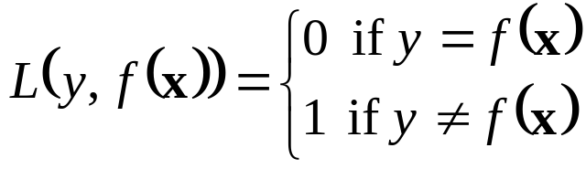
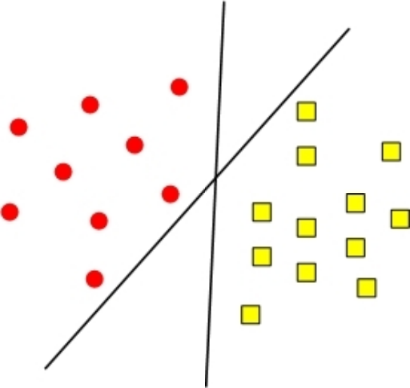
Recall (Binary) Classification problem:
Data in the form (x,y), where
- x is multivariate input (i.e. vector)
- y is univariate output (‘response’)
Classification: y is categorical (class label)
→ Estimation of indicator function

Slide 4
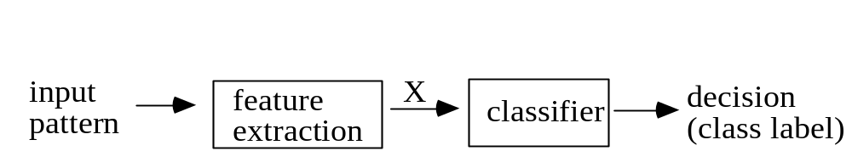
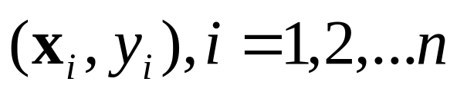
Pattern Recognition System (~classification)
Feature extraction: hard part - app.-dependent !
Classification: y ~ class label
y = (0,1,...J-1); J is the number of classes
Given training data
find decision rule that assigns class label to input x
~ Partition x-space into J disjoint regions
Classifier is intended for predicting future inputs

Slide 5
Classification vs Discrimination
In some apps, the goal is not prediction, but capturing the essential differences between the classes in the training data ~ discrimination
Example: Diagnosis of the causes of plane crash
Discrimination is related to explanation of past data
In this course, we are mainly interested in predictive classification
It is important to distinguish between:
- conceptual approaches (for classification) and
- constructive learning algorithms

Slide 6
Two Approaches to Classification
Risk Minimization vs. Generative approach
Risk Minimization (VC-theoretical) approach
- specify a set of models (decision boundaries) of increasing complexity (i.e., structure)
- minimize training error for each element of a structure (usually loss function ~ training error)
- choose model of opt. complexity, i.e. via resampling or analytic bounds
Loss function: should be specified a priori
Technical problem: non-convex loss function

Slide 7

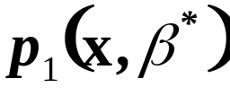


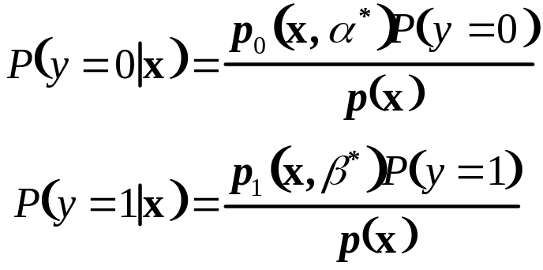
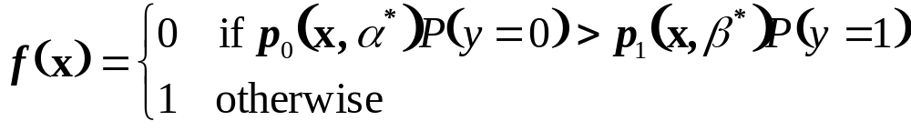
Statistical Decision Theory Approach
Parametric density estimation approach:
Class densities and are known or estimated from the training data
Prior probabilities and are known
The posterior probability that a given input x belongs to each class is given by Bayes formula:
Then Bayes optimal decision rule is

Slide 8
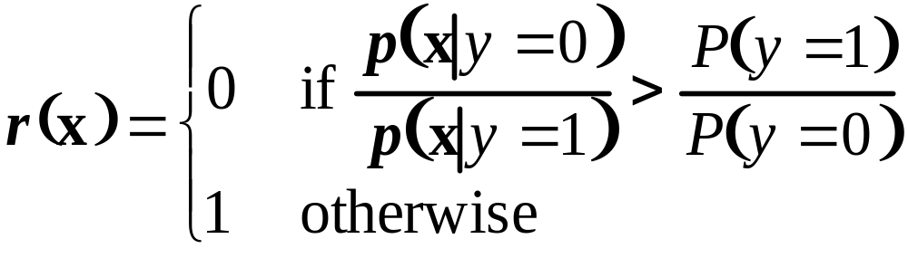
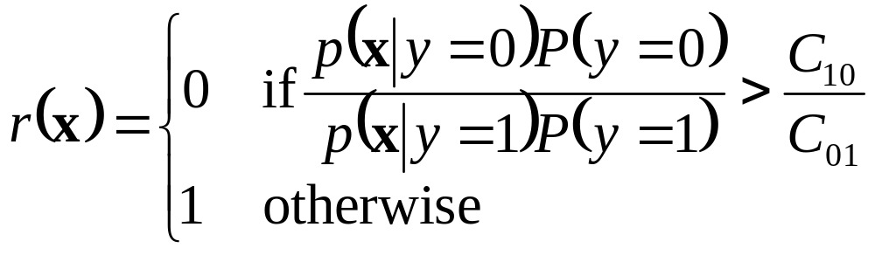
Bayes-Optimal Decision Rule
Bayes decision rule can be expressed in terms of the likelihood ratio:
More generally, for non-equal misclassification costs:
Only relative probability magnitudes are critical

Slide 9
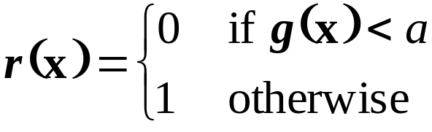
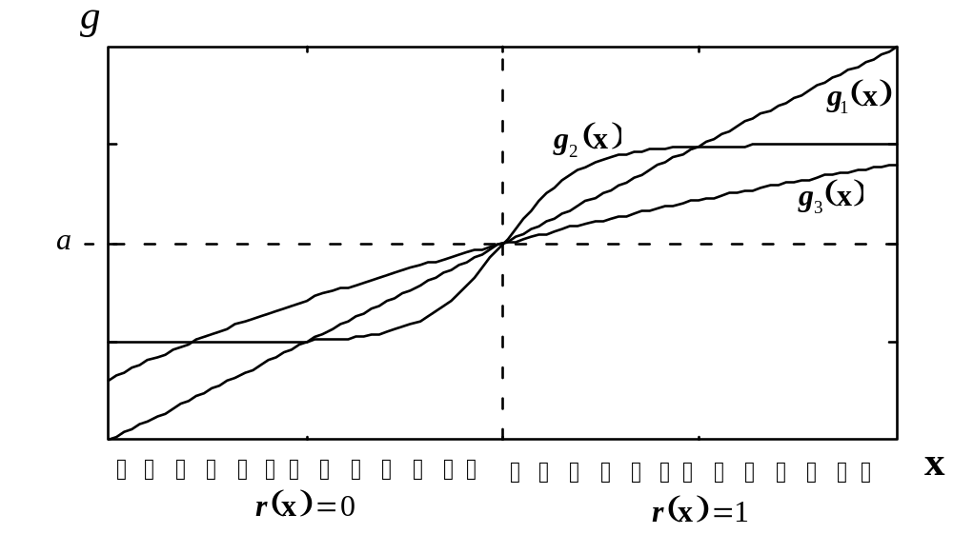
Discriminant Functions
Bayes decision rule in the form:
Discriminant function ~ probability ratio (or its monotonic transformation e.g. ln[g(x)]):

Slide 10
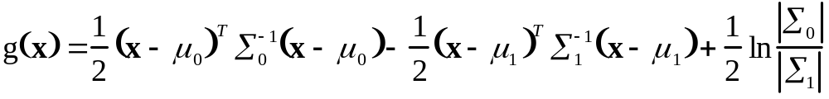
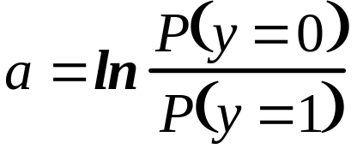
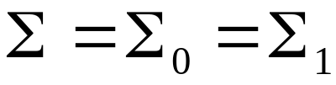
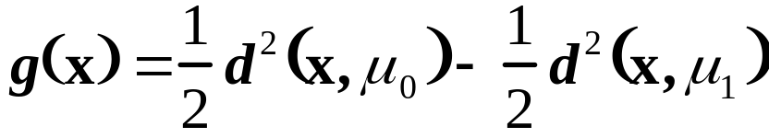
Decision boundary for known distributions
For known Gaussian class distributions optimal decision boundary can be calculated as
With a threshold
For equal covariance matrices
the discriminant fct is linear and can be expressed using the Mahalanobis distance from x to each class center

Slide 11
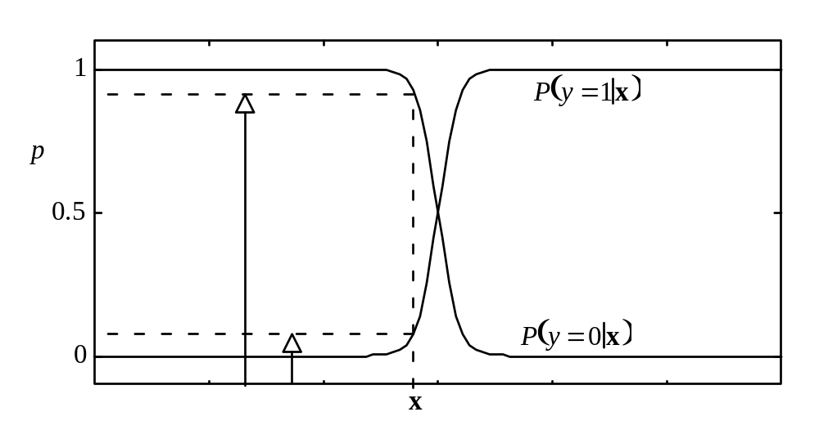
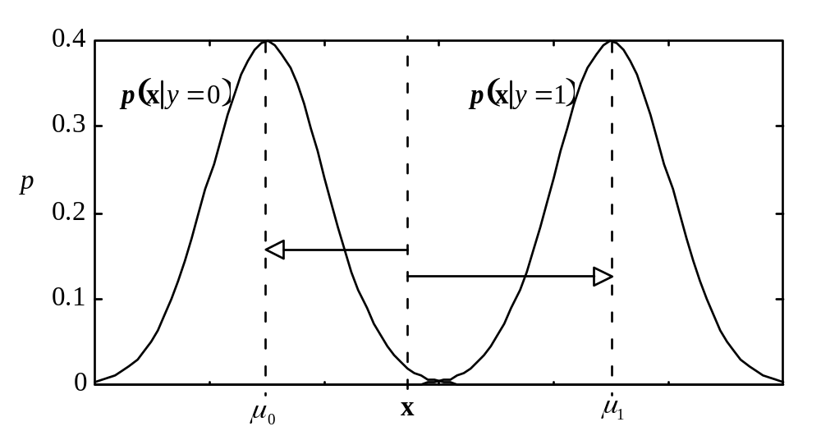
Two interpretations of the Bayes rule for Gaussian classes with the same covariance matrix

Slide 12
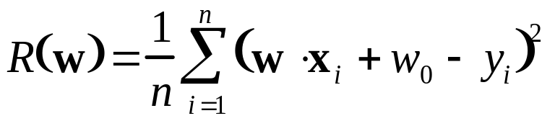
Posterior probability estimate via regression
For binary classification the class label is a discrete random variable with values Y={0,1}. Then for known distributions, the following equality between posterior probability and conditional expectation holds:
→ regression (with squared-loss) can be used to estimate approximately the posterior probability or discriminant fct
Example: linear discriminant function for Gaussian classes found by minimizing
Note: linear parameterization is often used even when distributions are not Gaussian (see Fig. 8.5 in textbook)

Slide 13
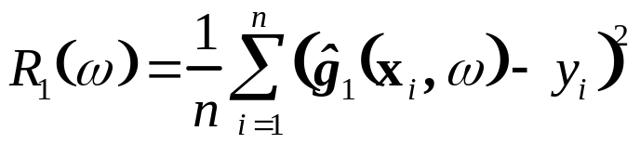

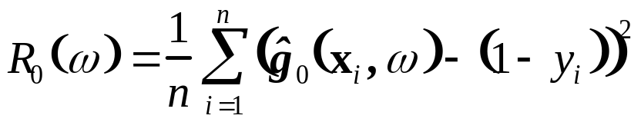
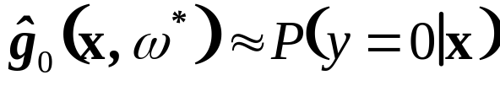
Regression-Based Methods
Generally, class distributions are unknown
→ need flexible (adaptive) regression estimators for posterior probabilities: MARS, RBF, MLP …
For two-class problems with (0,1) class labels, minimization of: yields
yields
For J classes use one – of - J encoding for class labels, and solve multiple-response regression problem.
i.e. for 3 classes output encoding is 100 010 001
The outputs of a trained multiple response regression model are then used as discriminant functions of a classifier.

Slide 14
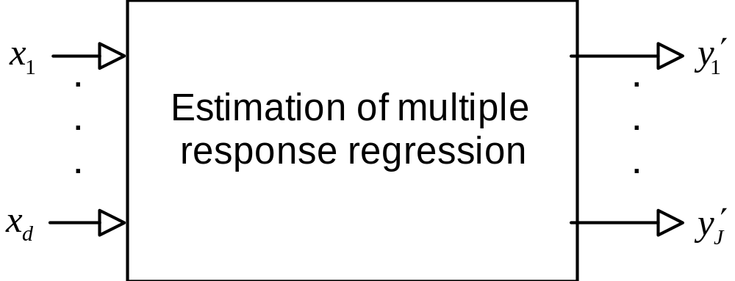
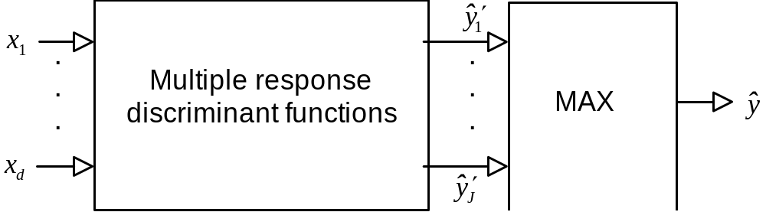
Regression-Based Methods (cont’d)
Training/Estimation
Prediction/Operation

Slide 15
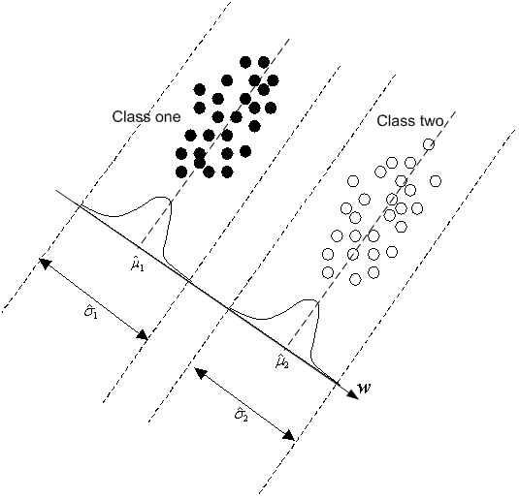
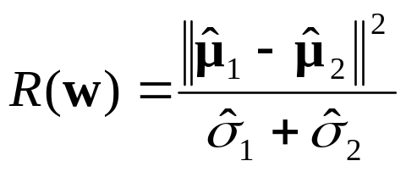
Fisher’s LDA
Classification method for high-dimensional data (motivated by statistical analysis for Gaussian class distributions)
Seeks optimal linear projection aimed to achieve maximum separation between two classes
Maximization of empirical index
- Works well for high-dim. data
- Related to linear regression or penalized (ridge) regression (see textbook)

Slide 16


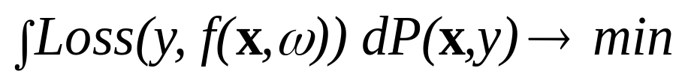
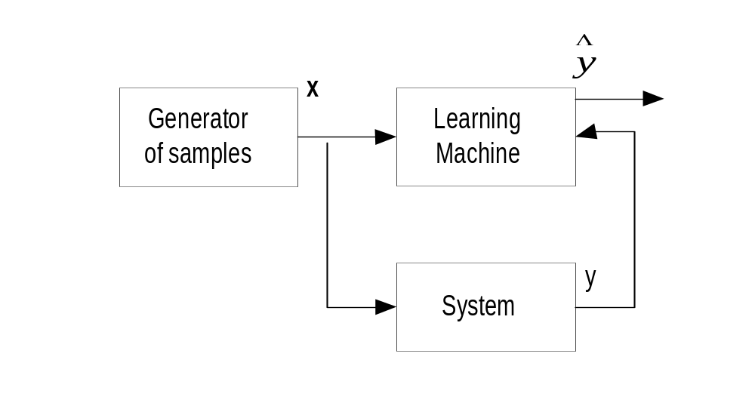
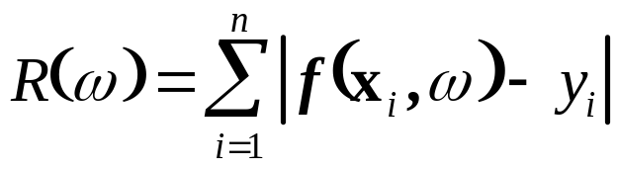
VC-theoretic Approach
The learning machine observes samples (x ,y), and returns an estimated response (indicator function)
Goal of Learning: find a function (model)
minimizing Prediction Risk:
Empirical Risk is

Slide 17
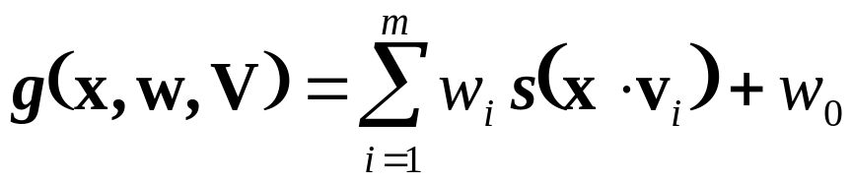
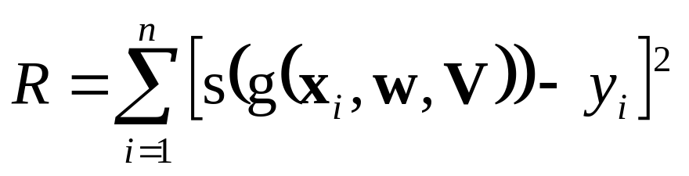
VC-theoretic Approach (cont’d)
Minimization of empirical risk
for each element of SRM structure may be difficult due to discontinuous loss + discontinuous indicator function
Solution Approach:
(1) Introduce flexible continuous parameterization, i.e. dictionary structure
(2) Minimize continuous risk functional (squared-loss)
→ MLP classifier (with sigmoid activation functions) ~ similar to multiple-response regression for classification

Slide 18
OUTLINE
Problem statement and approaches
Methods’ taxonomy
Representative methods for classification
Practical aspects and application study
Combining methods and Boosting
Summary

Slide 19
Methods’ Taxonomy
Estimating classifier from training data requires specification of :
(1) a set of indicator functions indexed by complexity
(2) loss function suitable for optimization
(3) optimization method
Optimization method (3) is related to loss fct (2)
→Taxonomy based on optimization method

Slide 20
Methods’ Taxonomy
Based on optimization method used:
- continuous nonlinear optimization (regression-based methods)
- greedy optimization (decision trees)
- local methods (estimate decision boundary locally)
Each type of methods has its particular implementation issues

Slide 21
Regression-Based Methods
Empirical loss functions
Note: there no direct connection btwn regression error & classification error for general distributions
Misclassification costs & prior probabilities
Representative methods: MLP, RBF and CTM classifiers

Slide 22
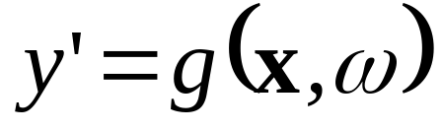
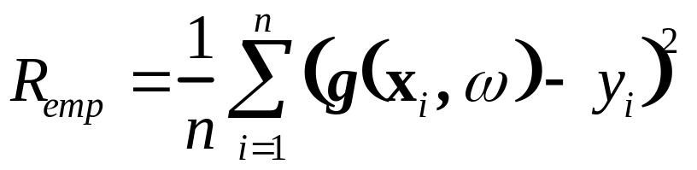
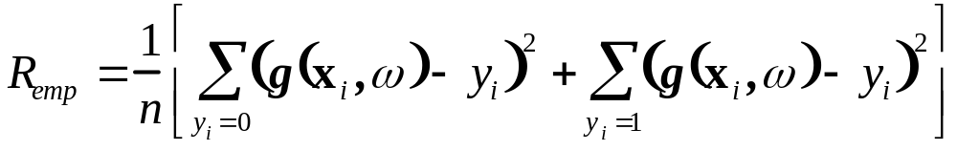
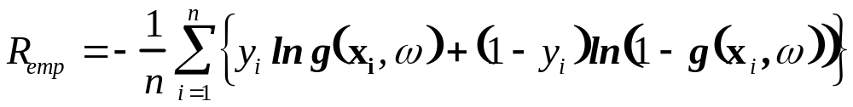
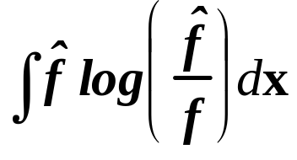
Empirical Loss Functions
An output of regression-based classifier
Squared loss
motivated by density estimation P(y=1/x)
Cross-entropy loss
motivated by density estimation via max likelihood and Kullbak-Leibler criterion

Slide 23
Empirical Loss Functions (cont’d)
Asymptotic results: outputs
of a trained network yield accurate estimates of posterior probabilities provided that
- sample size is very large
- an estimator has optimal complexity
In practice, none of these assumptions hold
Cross-entropy loss
- claimed to be superior to squared loss (for classification)
- can be easily adapted to MLP training (backpropagation)
VC-theoretic view: both squared and cross-entropy loss are just mechanisms for minimizing classification error.

Slide 24
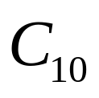
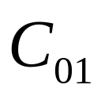
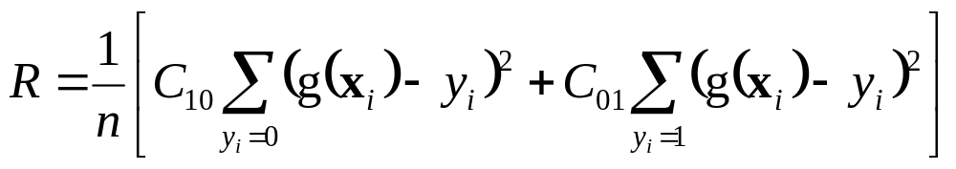
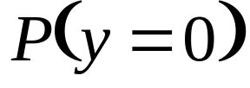
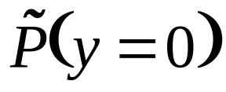
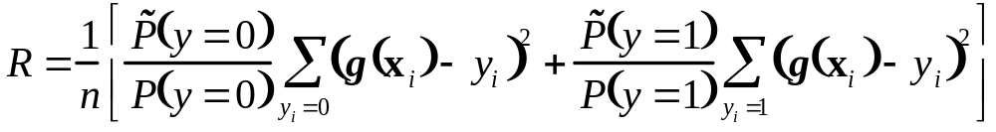
Misclassification costs + prior probabilities
For binary classification: class 0/1 (or -/+)
~ cost of false negative (true 1/ decision 0)
  ~ cost of false positive (true 0/ decision 1)
Known differences in prior probabilities for training and test data ~ and
NOTE: these prescriptions follow risk-minimization
→ Should be incorporated upfront into classification method

Slide 25
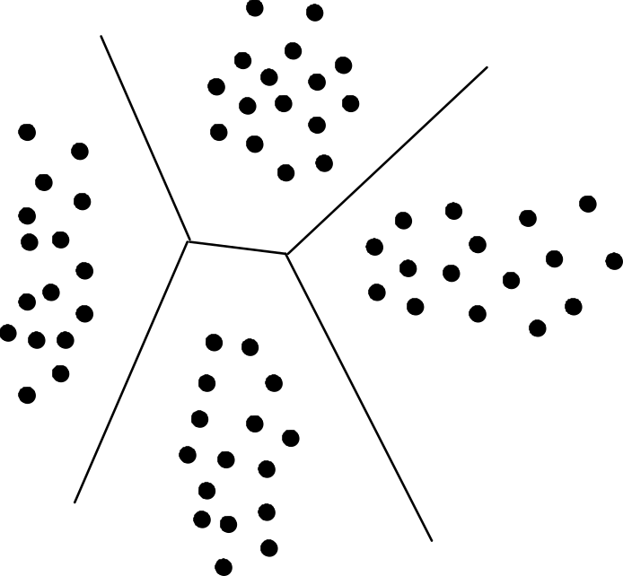
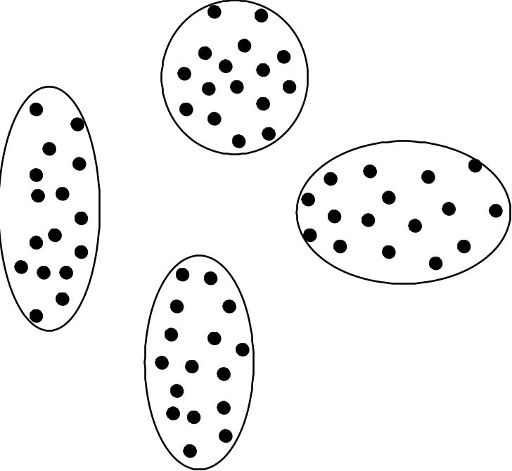
Example Regression-Based Methods
Regression-based classifiers can use: - global basis functions (i.e., MLP, MARS)
- local basis functions (i.e. RBF, CTM)
→ global vs local decision boundary

Slide 26
MLP Networks for Classification
Standard MLP network with J output units/classes: use 1-of-J encoding for the outputs
Practical issues for MLP classifiers
- prescaling of input values to [-0.5, 0.5] range
- initialization of weights (to small values)
- set training output (y) values: 0.1 and 0.9 rather than 0/1 (to avoid long training time)
Stopping rule (1) for training: keep decreasing squared error as long as it reduces classification error
Stopping rule (2) for complexity control: use classification error for resampling
Multiple local minima: use classification error to select good local minimum during training

Slide 27
RBF Classifiers
Standard multiple-output RBF network (J outputs)
Practical issues for RBF classifiers
- prescaling of input values to [-0.5, 0.5] range
- typically non-adaptive training (as for RBF regression) i.e. estimating RBF centers and widths via unsupervised learning, followed by estimation of weights W via OLS
Complexity control:
- usually the number of basis functions selected via resampling.
- classification error (not squared-error) is used for selecting optimal complexity parameter (~number of RBFs)
RBF Classifiers work best when the number of basis functions is small, i.e. training data can be accurately represented by a small number of ‘RBF clusters’.

Slide 28
CTM Classifiers
Standard CTM for regression: each unit has single output y implementing local linear regression
CTM classifier: each unit has J outputs (via 1-of-J encoding) implementing local linear decision boundary
CTM uses the same map for all outputs:
- the same map topology
- the same neighborhood schedule
- the same adaptive scaling of input variables
Prediction: local predictions using max output (of a unit)
Complexity control: determined by both:
- the final neighborhood size
- the number of CTM units (local basis functions)

Slide 29
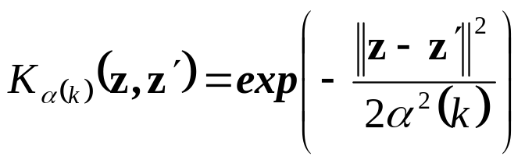
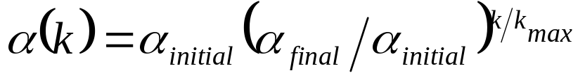
CTM Classifiers: complexity control
Heuristic strategy for complexity control + training
Find opt. number of units m* , via resampling, using fixed neighborhood schedule (with final width 0.05).
2. Determine the final neighborhood width by training CTM network with m* units on original training data. Optimal final width corresponds to min classification error (empirical risk)
Note: both (1) and (2) use classification error for tuning opt. parameters (through minimization of squared-error)

Slide 30
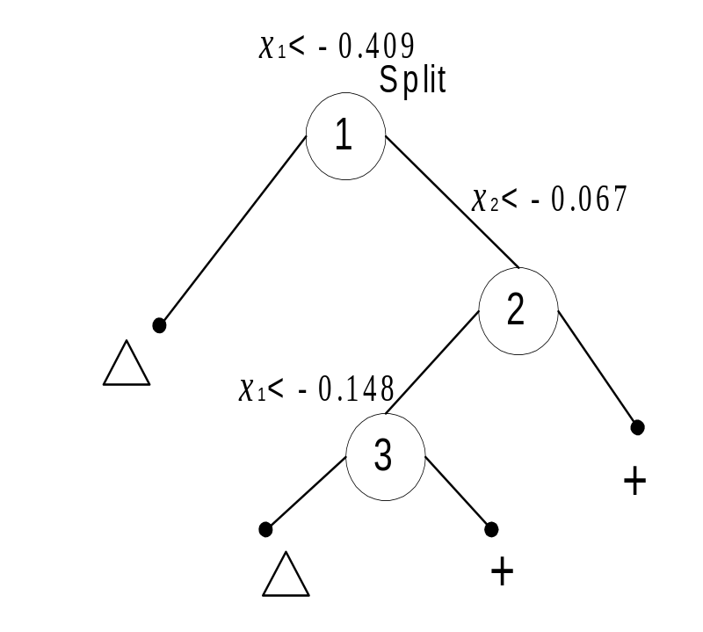
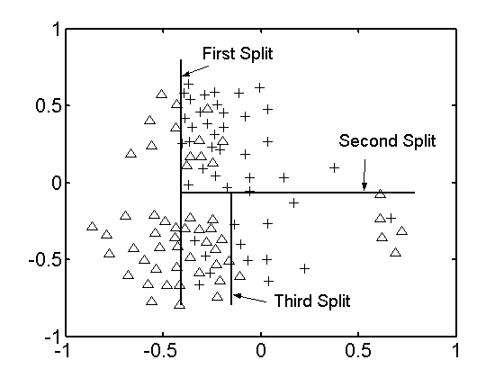
Classification Trees (CART)
Binary classification example (2D input space)
Algorithm similar to regression trees (tree growth via binary splitting + model selection), BUT using different empirical loss function

Slide 31

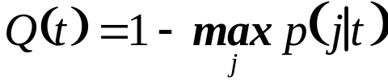
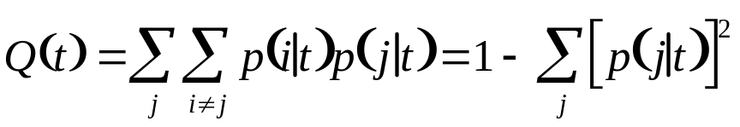
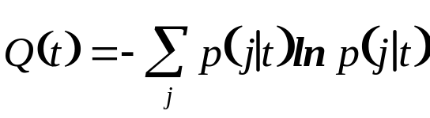
Loss Functions for Classification Trees
Misclassification loss: poor practical choice
Other loss (cost) functions for splitting nodes:
For J-class problem, a cost function is a measure of node impurity
where p(j/t) denotes the probability of class j samples at node t.
Possible cost functions
Misclassification
Gini function
Entropy function

Slide 32


Classification Trees: node splitting
Minimizing cost function = maximizing the decrease in node impurity. Assume node t is split into two regions (Left and Right) on variable k at a split point s. Then the decrease is impurity caused by this split
where and
Misclassification cost ~ discontinuous (due to max)
- may give sub-optimal solutions (poor local min)
- does not work well with greedy optimization

Slide 33


Using different cost fcts for node splitting
(a) Decrease in impurity:
misclassification = 0.25
gini = 0.13 entropy = 0.13
(b) Decrease in impurity:
misclassification = 0.25
gini = 0.17 entropy = 0.22
Split (b) is better as it leads to a smaller final tree

Slide 34









Details of calculating decrease in impurity
Consider split (a)
Misclassification Cost
Gini Cost

Slide 35

IRIS Data Set: A data set with 150 random samples of flowers from the iris species setosa, versicolor, and virginica (3 classes). From each species there are 50 observations for sepal length, sepal width, petal length, and petal width in cm. This dataset is from classical statistics
MATLAB code (splitmin =10)
load fisheriris;
t = treefit(meas, species);
treedisp(t,'names',{'SL' 'SW' 'PL' 'PW'});

Slide 36

Another example with Iris data:
Consider IRIS data set where every other sample is used (total 75 samples, 25 per class). Then the CART tree formed using the same Matlab software (splitmin = 10, Gini loss fct)) is

Slide 37



CART model selection
Model selection strategy
(1) Grow a large tree (subject to min leaf node size)
(2) Tree pruning by selectively merging tree nodes
The final model ~ minimizes penalized risk
where empirical risk ~ misclassificatiion rate
number of leaf nodes ~
regularization parameter ~ (via resampling)
Note: larger → smaller trees
In practice: often user-defined (splitmin in Matlab)

Slide 38
Decision Trees: summary
Advantages
- speed
- interpretability
- different types of input variables
Limitations: sensitivity to
- correlated inputs
- affine transformations (of input variables)
- general instability of trees
Variations: ID3 (in machine learning), linear CART

Slide 39
Local Methods for Classification
Decision boundary constructed via local estimation (in x-space)
Nearest Neighbor (k-NN) classifiers
- define a metric (distance) in x-space and choose k (odd)
- for given test input x, find k-nearest training samples
- classify x as class A, if the majority of its k-nearest neighbors are from class A
Statistical Interpretation: local estimation of class probability
VC-theoretical interpretation: estimation of decision boundary via minimization of local empirical risk
Note: local methods effective for large-sample settings

Slide 40



Local Risk Minimization Framework
Similar to local risk minimization for regression
Local risk for binary classification
here for k closest samples, and 0 otherwise;
parameter takes on the discrete values [0,1]
Local risk is minimized when takes the value of the majority of class labels.
NOTE that local risk is minimized directly (no training is needed)

Slide 41
Nearest Neighbor Classifiers
Advantages
- easy to implement
- no training needed
Limitations
- choice of distance metric
- irrelevant inputs contribute to noise
- computational performance when training size is large (especially with high-dimensional data)
Computationally efficient variations
- tree implementations of k-NN
- condensed k-NN

Slide 42
OUTLINE
Problem statement and approaches
Methods’ taxonomy
Representative methods for classification
Practical aspects and examples
- Problem formalization
- Data Quality
- Promising Application Areas
Combining methods and Boosting
Summary

Slide 43
Data Quality
Data is obtained under observational setting,
NOT as a result of scientific experiment
→ Always question integrity of the data
Example 1: Stock market data
- stock market data: dividend distribution, holidays
Example 2: Pima Indians Diabetes Data (UCI Database)
- 35 out of 768 total samples (female Pima Indians) show blood pressure value of zero
Example 3: Transportation study on
Safety Performance of Compliance Reviews

Slide 44
Promising Application Areas
Financial Applications (Financial Engineering)
- misunderstanding of predictive learning, i.e. backtesting
- main problem: what is/ how to measure risk?
misunderstanding of uncertainty/ risk
- non-stationarity → can use only short-term modeling
Successful investing: two extremes
(1) Based on fundamentals/ deep understanding
→ Buy-and-Hold (Warren Buffett)
(2) Short-term, purely quantitative (predictive learning)
Always involves risk (~ losing money)

Slide 45
Promising Application Areas
Biomedical + Life Sciences
- great social+practical importance
- main problem:
cost of human life should be agreed upon by society
- ineffectiveness of medical care: due to existence of many subsystems that put different value on human life
Two possible applications of predictive learning
(1) Imitate diagnosis performed by human doctors
→ training data ~ diagnostic decisions made by humans
(2) Substitute human diagnosis/ decision making
→ training data ~ objective medical outcomes
ASIDE: Medical doctors expected/required to make no errors

Slide 46
OUTLINE
Problem statement and approaches
Methods’ taxonomy
Representative methods for classification
Practical aspects and examples
Combining Methods and Boosting
Summary

Slide 47
Strategies for Combining Methods
Predictive model depends on 3 factors
(a) parameterization of admissible models
(b) random training sample
(c) empirical loss (for risk minimization)
Three combining strategies (for better prediction)
1. Different (a), the same (b) and (c)
→ Committee of Networks, Stacking, Bayesian averaging
2. Different (b), the same (a) and (c)
→ Bagging
3. Different (c), the same (a) and (b)
→ Boosting

Slide 48
Combining strategy 3 (Boosting)
Boosting: apply the same method to training data, where the data samples are adaptively weighted (in the empirical loss function)
Boosting: designed and used for classification
Implementation of Boosting:
- apply the same method (base classifier) to many (modified) realizations of training data
- combine the resulting model as a weighted average

Slide 49

Boosting strategy
Apply learning method to many realizations of the data

Slide 50











AdaBoost algorithm (Freund and Schapire, 1996)
Given training data (binary classification):
Initialize sample weights:
Repeat for
1. Apply the base method to the training samples with weights , producing the component model
2. Calculate the error for the classifier and its weight:
3. Update the data weights
Combine classifiers via weighted majority voting:

Slide 51


Example of AdaBoost algorithm
original training data: 10 samples

Slide 52




First iteration of AdaBoost
First (weak) classifier Sample weight changes

Slide 53


Second iteration of AdaBoost
Second (weak) classifier Sample weight changes

Slide 54

Third iteration of AdaBoost
Third (weak) classifier

Slide 55


Combine base classifiers

Slide 56

Example of AdaBoost for classification
75 training samples: mixture of three Gaussians centered at (-2,0), (2,0) ~ class 1, and at (0,0) ~ class -1
600 test samples (from the same distribution)

Slide 57


Example (cont’d)
Base classifier:
(decision stump)
The first 10 component classifiers are shown

Slide 58

Example (cont’d)
Generalization performance (m = 100 iterations)
Training error decreases with m (can be proven)
Test error does not show overfitting for large m

Slide 59

Relation of boosting to other methods
Why boosting can generalize well, in spite of the large number of component models (m)?
What controls the complexity of boosting?
AdaBoost final model has an additive form
- can be related to additive methods (statistics)
Generalization performance can be related to large-margin properties of the final classifier

Slide 60


Boosting as an additive method
Dictionary methods:
MLP and RBF: basis fcts are specified a priori → model complexity ~ number of basis functions
Projection Pursuit: basis fcts are estimated sequentially via greedy strategy (backfitting) → model complexity difficult to estimate
Boosting can be shown to implement the backfitting procedure (similar to Projection Pursuit) but using an appropriate loss function

Slide 61








Stepwise form of AdaBoost algorithm
Given training data (binary classification):
a base classifier
and empirical loss
Initialization
Repeat for
1. Determine parameters and via minimization of
2. Update the discriminant function
Classification rule

Slide 62


Various loss functions for classification
Exponential loss (AdaBoost)
SVM loss (SVM classifier)

Slide 63
Generalization Performance of AdaBoost
Similarity between SVM and exponential loss helps to explain good performance of AdaBoost
Boosting tends to increase the degree of separation between two classes (margin)
Generalization properties poorly understood
Complexity control via
- the number of components
- complexity of a base classifier
Poor performance for very noisy data sets

Slide 64



Example 1: Hyperbolas Data Set
x₁ = ((t-0.4)*3)²+0.225
x₂ = 1-((t-0.6)*3)²-0.225.
for class 1.(Uniform)
for class 2.(Uniform)
Gaussian noise with st. dev. = 0.03 added to both x₁ and x₂
100 Training samples (50 per class)/ 100 Validation.
2,000 Test samples (1000 per class).

Slide 65


AdaBoost using decision stumps:
Model selection: choose opt N using validation data set.
Repeat experiments 10 times

Slide 66
AdaBoost Performance Results
Experiment number | training error | validation error | test error | Optimal N
1 | 0 | 0.02 | 0.0275 | 32
2 | 0 | 0.01 | 0.0115 | 16
3 | 0 | 0.07 | 0.044 | 32
4 | 0 | 0.02 | 0.0115 | 32
5 | 0 | 0.06 | 0.0235 | 32
6 | 0 | 0.03 | 0.036 | 16
7 | 0 | 0.03 | 0.018 | 16
8 | 0 | 0.02 | 0.016 | 32
9 | 0 | 0.05 | 0.0225 | 32
10 | 0 | 0 | 0.0185 | 16
Ave | 0 | 0.031 | 0.0229
St. dev. | 0 | 0.0223 | 0.0105
Test error: AdaBoost ~ 2.29% vs RBF SVM ~ 0.42%

Slide 67
OUTLINE
Problem statement and approaches
Methods’ taxonomy
Representative methods for classification
Practical aspects and examples
Combining methods and Boosting
Summary

Slide 68
Discussion
Predictive risk minimization and statistical approaches often yield similar learning methods
But the conceptual basis & motivation are different
→ may result in confusion
This difference may lead to variations in:
- empirical loss function
- implementation of complexity control
- interpretation of the trained model outputs
- evaluation of classifier performance
Many good learning methods follow the risk-minimization approach, even when introduced via statistical arguments

Slide 69






Example: classification problem
Predictive approach: minimize the fitting error
Decision rule
Loss function
Fitting error
Approximate
Ind via sigmoid
→Logistic regression

Slide 70
SUMMARY
VC-theoretic approach to classification
- minimization of empirical error
- structure on a set of indicator functions
Importance of continuous loss function suitable for minimization
Simple methods (local or linear classifiers) are often better than nonlinear, especially for high-dim. problems
Classification may be less sensitive to optimal complexity control (vs. regression)

